Slide 1
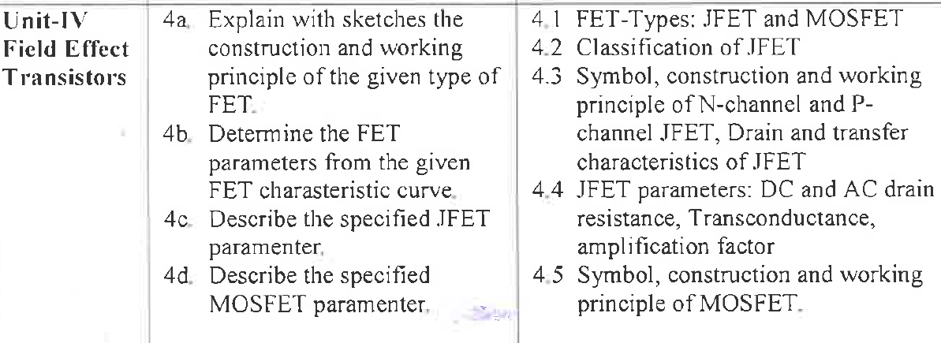
Unit 4:FET

Slide 2
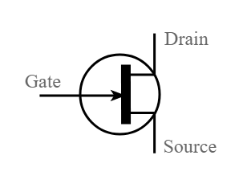
What is FET?
A Field Effect Transistor (FET) is a three-terminal Active semiconductor device, where the output current is controlled by an electric field generated by the input voltage.
The field-effect transistor (FET) is a type of transistor that uses an electric field to control the flow of current in a semiconductor.

Slide 3
FETs are also known as unipolar transistors since they involve single-carrier-type operation. That is, FETs use either electrons or holes as charge carriers in their operation, but not both.
FET is uni-polar device i.e. operation depends on only one type of charge carriers (h or e) .
It is a Voltage controlled Device (gate voltage controls drain current)

Slide 4
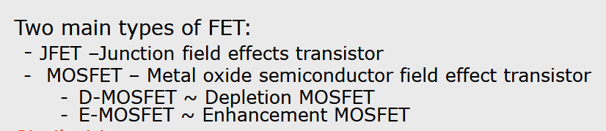
Types of FET

Slide 5
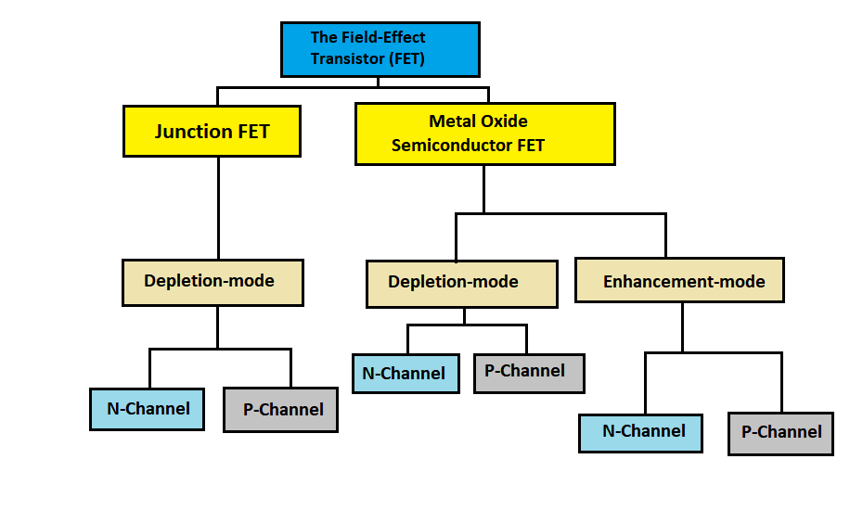
Classification of FET

Slide 6
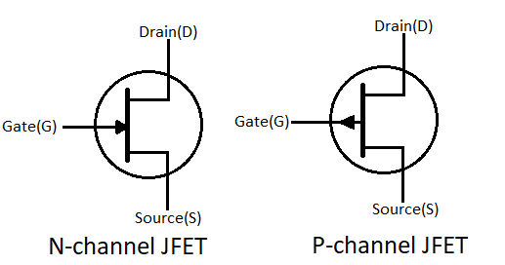
JFET
A JFET is a three terminal semiconductor device in which current conduction is by one type of carrier i.e. electrons or holes.
The current conduction is controlled by means of an electric field between the gate and the conducting channel of the device.
The JFET has high input impedance and low noise level.

Slide 7
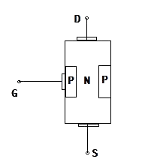
Construction of JFET
N – Channel JFET −It consists of an n – type silicon bar forming the conduction channel for the charge carriers. The pn – junction forming diodes are connected internally and a common terminal called GATE is taken out from the p - Region. The other two terminals viz. Source and Drain are taken out from the bar.

Slide 8
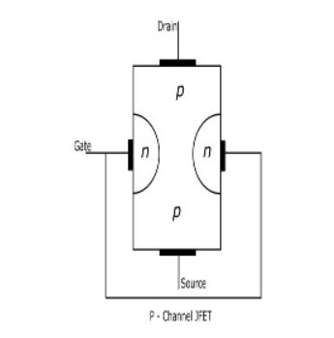
P – Channel JFET − It consists of a p – type silicon bar forming the conduction channel for the charge carriers. The pn – junction forming diodes are connected internally and a common terminal called GATE is taken out from the n - Region. The other two terminals viz. Source and Drain are taken out from the bar.

Slide 9
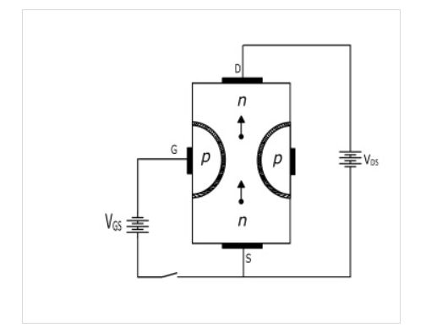
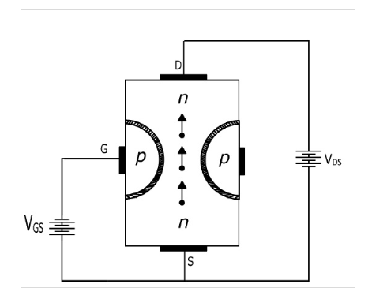
Working Principle of JFET

Slide 10
When voltage VDS is applied between the drain and source terminals and gate terminal voltage is zero, the two pn-junctions at the sides establishes depletion layers. The electrons flow from source to drain through the channel between the depletion layers. The width of these depletion layers determine the width of the channel and hence the current conduction through the bar.
Now, when a reverse voltage V_{GS} is applied between the gate and the source terminals, the width of depletion layers is increased and this decreases the width of the conduction channel, thereby increasing the resistance of conduction channel. Consequently, the current from source to drain is decreased. On the other hand, when the reverse voltage V_{GS} is decreased the width of depletion layer also decreases. Hence, the width of conduction channel increases and the resulting source to drain current.
Therefore, the current from source to drain can be controlled by the application voltage (electric field) on the gate terminal. For this reason it is known as Field Effect Transistor.
Hence, the JFET operates on the principle that the width and resistance of conduction channel can be varied by changing the reverse voltage V_{GS}.

Slide 11
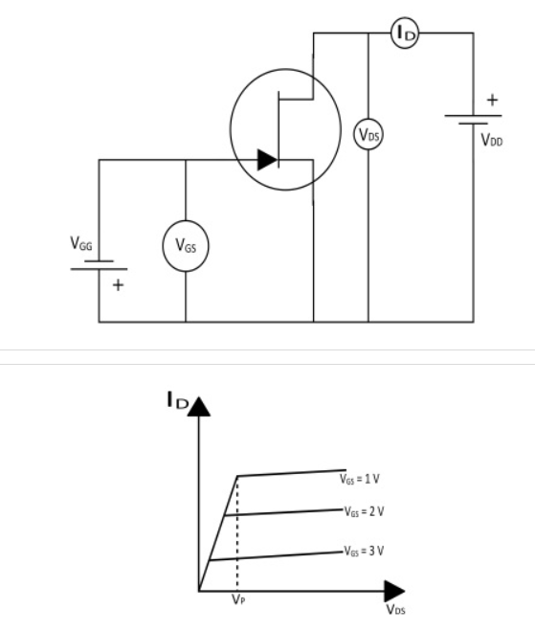
Drain or Output Characteristics of JFET
The curve showing the relation between the drain current (I_{D}) and the drain-source voltage (V_{DS}) at constant gate-source voltage (V_{GS}) is known as the Output or Drain Characteristics of JFET.
At the start, the drain current (ID) increases rapidly with increase in drain-source voltage (VDS) but then becomes constant. The value of VDS above which the drain current becomes constant is called as Pinch off Voltage (V_{P}).
After pinch off voltage, the channel width becomes so narrow that the depletion layers touch each other. Therefore, after pinch off voltage the change in the drain current is small with change in the VDS. Hence, the drain current remains constant.

Slide 12
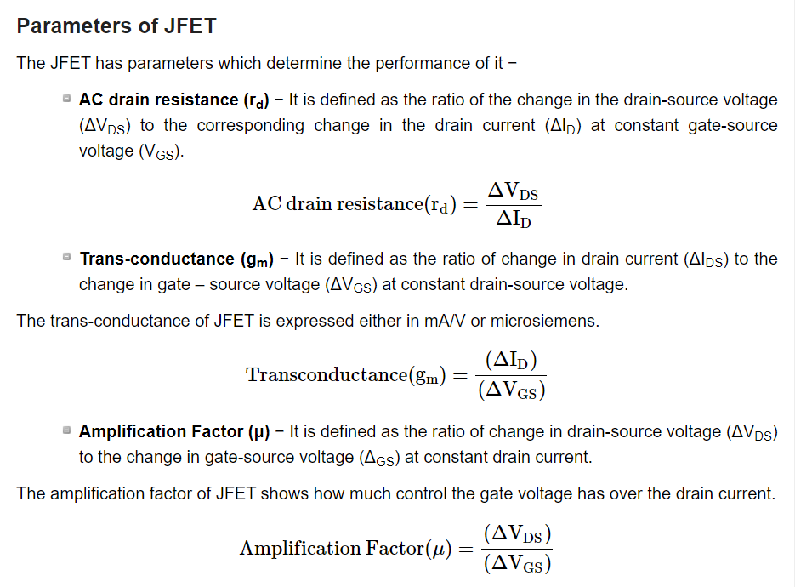

Slide 13
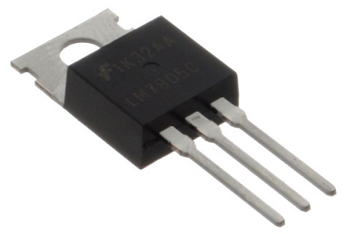
MOSFET
FETs have a few disadvantages like high drain resistance, moderate input impedance and slower operation. To overcome these disadvantages, the MOSFET which is an advanced FET is invented.
MOSFET stands for Metal Oxide Silicon Field Effect Transistor or Metal Oxide Semiconductor Field Effect Transistor.
This is also called as IGFET meaning Insulated Gate Field Effect Transistor. The FET is operated in both depletion and enhancement modes of operation. The following figure shows how a practical MOSFET looks like.

Slide 14
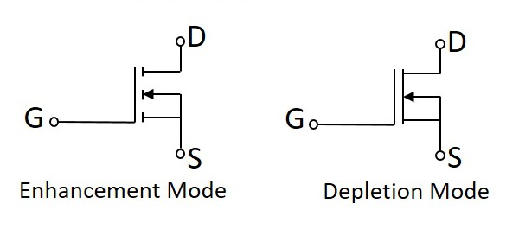
Symbol of n-channel MOSFET

Slide 15
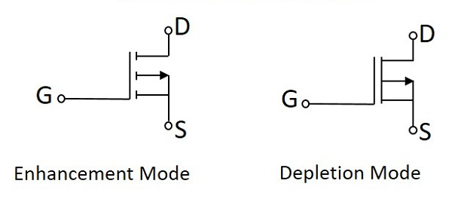
Symbol of p-channel MOSFET

Slide 16
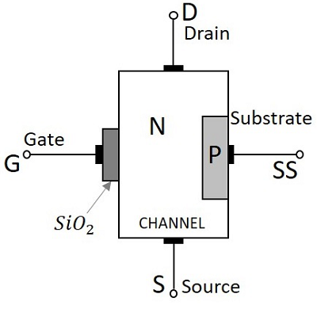
Construction of a MOSFET
The construction of a MOSFET is a bit similar to the FET.
An oxide layer is deposited on the substrate to which the gate terminal is connected. This oxide layer acts as an insulator (sio₂ insulates from the substrate), and hence the MOSFET has another name as IGFET.
In the construction of MOSFET, a lightly doped substrate, is diffused with a heavily doped region. Depending upon the substrate used, they are called as P-type and N-type MOSFETs.
The following figure shows the construction of a MOSFET.

Slide 17
Continue..
The voltage at gate controls the operation of the MOSFET. In this case, both positive and negative voltages can be applied on the gate as it is insulated from the channel. With negative gate bias voltage, it acts as depletion MOSFET while with positive gate bias voltage it acts as an Enhancement MOSFET.

Slide 18
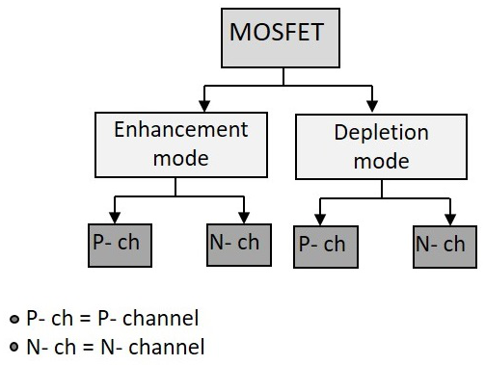
Classification of MOSFETs
Depending upon the type of materials used in the construction, and the type of operation, the MOSFETs are classified as in the following figure.

Slide 19
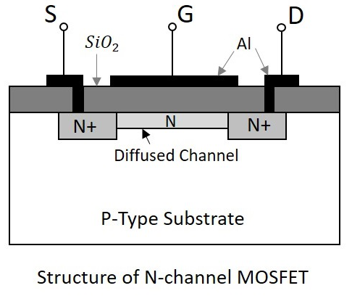
Construction of N- Channel MOSFET
Let us consider an N-channel MOSFET to understand its working. A lightly doped P-type substrate is taken into which two heavily doped N-type regions are diffused, which act as source and drain. Between these two N+ regions, there occurs diffusion to form an N channel, connecting drain and source.

Slide 20
Continue..
A thin layer of Silicon dioxide (SiO₂) is grown over the entire surface and holes are made to draw ohmic contacts for drain and source terminals. A conducting layer of aluminum is laid over the entire channel, upon this SiO₂ layer from source to drain which constitutes the gate. The SiO₂ substrate is connected to the common or ground terminals.
Because of its construction, the MOSFET has a very less chip area than BJT, which is 5% of the occupancy when compared to bipolar junction transistor. This device can be operated in modes. They are depletion and enhancement modes.

Slide 21
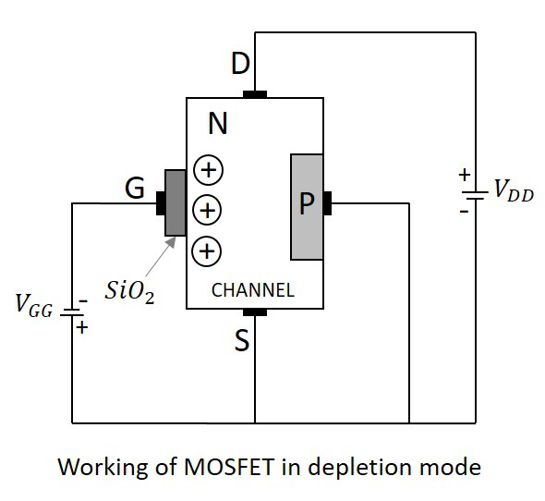
Working of N - Channel depletion mode depletion mode MOSFET

Slide 22
For now, we have an idea that there is no PN junction present between gate and channel in this, unlike a FET. We can also observe that, the diffused channel N between two N+regions between two +regions, the insulating dielectric SiO₂ and the aluminum metal layer of the gate together form a parallel plate capacitor.
If the NMOS has to be worked in depletion mode, the gate terminal should be at negative potential while drain is at positive potential, as shown in the following figure.
When no voltage is applied between gate and source, some current flows due to the voltage between drain and source. Let some negative voltage is applied at V_{GG}. Then the minority carriers i.e. holes, get attracted and settle near SiO₂ layer. But the majority carriers, i.e., electrons get repelled.
With some amount of negative potential at V_{GG} a certain amount of drain current I_{D} flows through source to drain. When this negative potential is further increased, the electrons get depleted and the current I_{D} decreases. Hence the more negative the applied V_{GG}, the lesser the value of drain current I_{D} will be.
The channel nearer to drain gets more depleted than at source like in FET like in FET and the current flow decreases due to this effect. Hence it is called as depletion mode MOSFET.

Slide 23
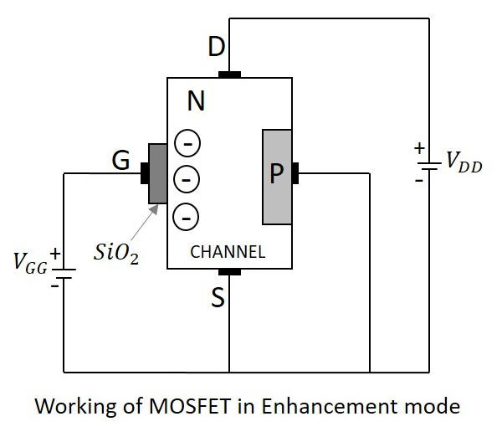
Working of N-Channel MOSFET Enhancement Mode
The same MOSFET can be worked in enhancement mode, if we can change the polarities of the voltage V_{GG}. So, let us consider the MOSFET with gate source voltage V_{GG} being positive as shown in the following figure.

Slide 24
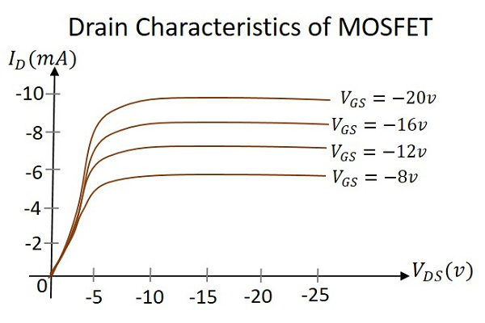
Drain Characteristics
The drain characteristics of a MOSFET are drawn between the drain current I_{D} and the drain source voltage V_{DS}. The characteristic curve is as shown below for different values of inputs.
Actually when V_{DS} is increased, the drain current I_{D} should increase, but due to the applied V_{GS}, the drain current is controlled at certain level. Hence the gate current controls the output drain current.

Slide 25
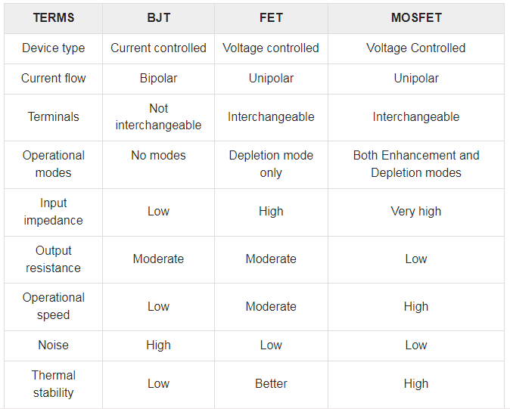
Comparison between BJT, FET and MOSFET

Slide 26
